Slide 1
Rethinking the Future – A series of four lectures – by Joseph A. Camilleri Hosted by St Michael’s on Collins Melbourne
Lecture 3 | Islam, the Middle East and the West before and since 9/11

Slide 2
Resources
Website
www.Josephcamilleri.org

Slide 3
Resources
Resources
The Oxford Research Group (ORG) is a leading independent think-tank that has been influential for 30 years in pioneering the idea of sustainable approaches to security as an alternative to violent global confrontation, through original research, wide-ranging dialogue, and practical policy recommendations.
http://www.oxfordresearchgroup.org.uk/middle_east

Slide 4
Resources
The International Crisis Group is an independent, non-profit, non-governmental organisation committed to preventing and resolving deadly conflict.
http://www.crisisgroup.org/en/regions/middle-east-north-africa.aspx

Slide 5
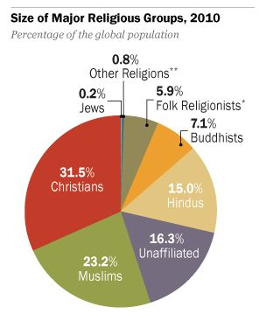
Global Religious Landscape report December 2012 Pew Research Center’s Forum on Religion & Public Life

Slide 7
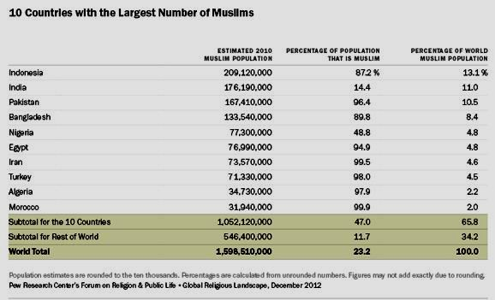

Slide 8
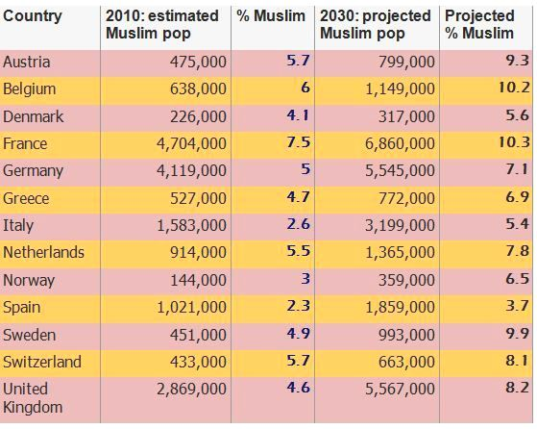
Muslim Populations in Western Europe

Slide 9
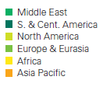
From: BP Statstical Review of World Energy 2014 Proved oil reserves at end 2013

Slide 10
Production by Region 2013

Slide 11
Price of Oil

Slide 12
Reserves to Production (R/P) Ratios – Years

Slide 13
Major Oil trade Movements (millions tonnes)

Slide 14
Natural Gas Reserves to Production Ratio (years) 2013

Slide 15
Distribution of Proved Reserves in 1993, 2003 and 2013 Percentage

Slide 16
Choke Points ____________________________
The Muslim world borders or encompasses key choke points around the world, including:
Strait of Gibraltar
The Dardanelles and the Bosphorus
The Suez Canal
Bab el Mandeb
The Strait of Hormuz
The Strait of Malacca
Straits contained within Indonesian archipelago

Slide 17
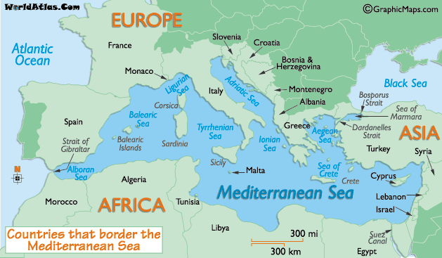
Mediterranean Sea

Slide 18
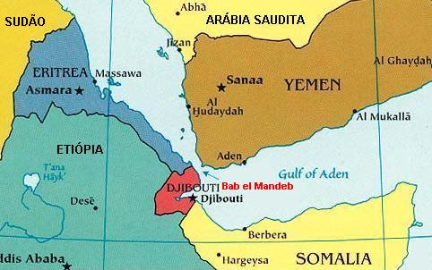
Bab el Mandeb

Slide 19
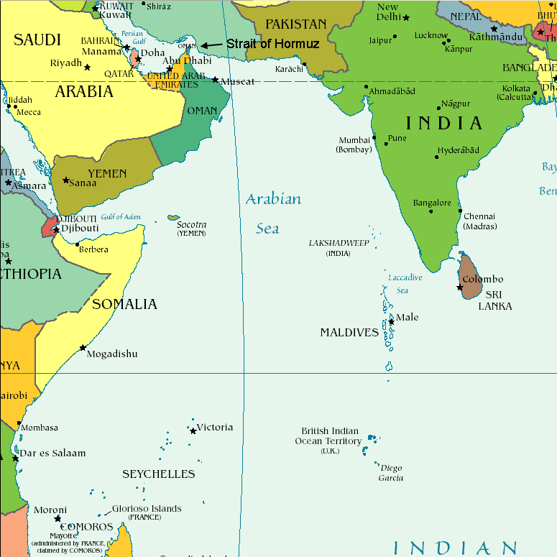
Strait of Hormuz

Slide 20
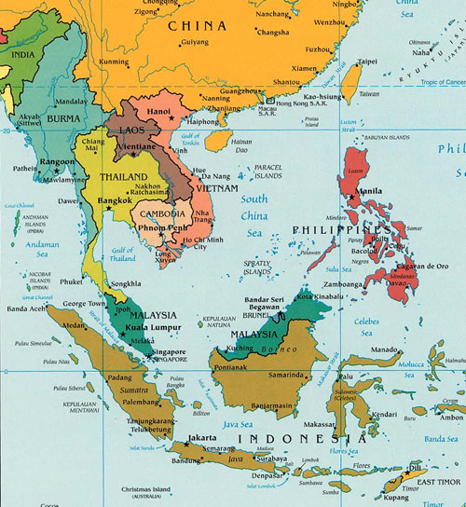
Southeast Asia

Slide 21
The Middle East

Slide 22
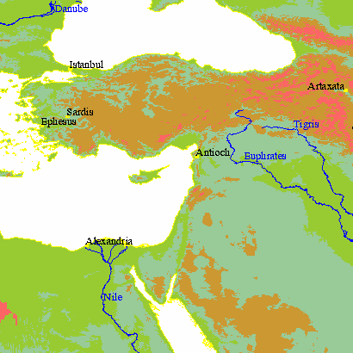
. . . a place steeped in history
the birthplace
of the three Abrahamic Faiths

Slide 23
. . . an unending list of conflicts
World War I
World War II
Arab-Israeli conflict
1948 Arab-Israeli War
1956 Suez War
1967 Six Day War
1969-1970 War of Attrition
1973 Yom Kippur War
1982 Lebanon War
1987-1993 First Intifada
1982-2000 South Lebanon conflict
2000-2007 al-Aqsa Intifada
2006 Lebanon War
2008-2009 Israel-Gaza conflict
2014 Gaza Conflict

Slide 24
. . . an unending list of conflicts
Jordan-Syria tensions
Black September (1970)
North Yemen Civil War (1962–1970)
The Cyprus dispute
Lebanese civil war (1975–1990)
Libya-Egypt conflict
Iraq-Kuwait clashes (1967-1991)
The Iran–Iraq War (1980-1988)
Gulf War and aftermath (1990-1991)
Iraq War (2003-)
Libya conflict ( 2011-)
Syria conflict (2011-)

Slide 25
. . . a place of division and conflict ISRAEL-PALESTINE
Gaza Strip = sandwiched between Israel and Egypt
= recurring flashpoint in Israel-Palestinian conflict
Israel occupied Gaza in 1967 Middle East war and pulled its troops and settlers out in 2005.
This was meant to be the end of the occupation, but Israel still exercises control over most of Gaza's borders, waters and airspace.
Egypt controls Gaza's southern border

Slide 26
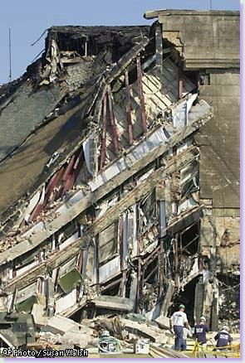
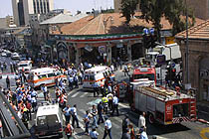
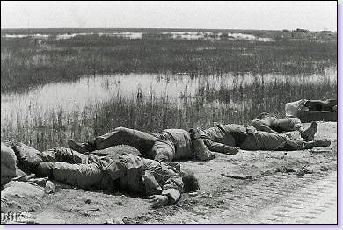
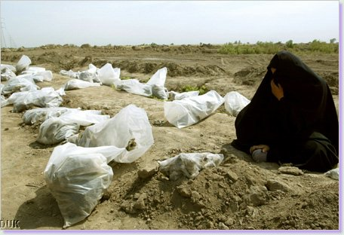
. . . a place of devastation

Slide 27
. . . but also a place of coexistence

Slide 28
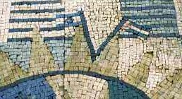
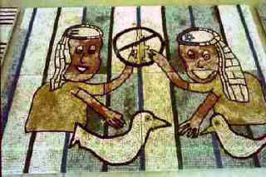
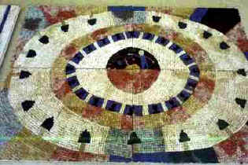
. . . and a deep yearning for peace More than 150 Palestinian and Israeli youth met over 3 years to create 330 square feet of mosaic.

Slide 29
Terrorism
& war on Terror

Slide 30
ATTACKS ON US INTERESTS PRIOR TO SEPTEMBER 11
April 1983 Suicide bombing outside US embassy in West Beirut, 63 killed including 17 Americans, 100 wounded including 40 Americans
Oct 1983 Suicide bomb attacks on US Marines Compound (241 killed and over 100 wounded)
Sept 1984 UN embassy building East Beirut attacked by suicide bomber leaving 8 dead and dozens wounded
June 1985 TWA airliner hijacked. 39 hostages freed after 2 weeks
Dec 1988 Lockerbie disaster, 270 killed
Feb 1993 Car bomb explosion at World Trade Center NY: 6 killed, 1,000 injured
June 1996 Car bomb destroys transport facility, Saudi Arabia, 19 killed, 515 injured
Nov 1997 Mass shooting at Luxor, 62 (mostly European & Japanese tourists) killed
Aug 1998 Car bomb attacks on 2 US embassies with a total of 5,341 casualties
Oct 2000 Suicide attack on the USS Cole docked in Yemen, 17 dead 30 injured.

Slide 31
ATTACKS ON US INTERESTS SINCE SEPTEMBER 11
2002
11 April Bomb attack on synagogue in Tunisia kills 21 people, including 18 German tourists
6 October A crew member dies after bomb attack on French oil tanker off the coast of Yemen
12 October A bomb explodes in Bali nightclub killing 202 people, many of them Westerners
28 November 2 attacks launched against Israeli targets in Mombasa, Kenya – hotel blast kills 16

Slide 32
MAJOR ATTACKS BLAMED ON AL QAEDA SINCE SEPTEMBER 11
2003
16 May Casablanca hit by series of suicide bombings that kill 41 people, including 12 attackers
12 May At least 34 people killed in bomb attacks in Riyadh – carried out against luxury compounds housing foreign nationals and offices of US-Saudi company
8 November Bomb attack on housing complex in Riyadh, Saudi Arabia – 17 people are killed and more than 100 injured in the blast, mostly foreign Arab workers
5 November At least 23 people killed and more than 300 injured in two devastating attacks on synagogues in Istanbul
20 November In coordinated attacks on British Consulate and the HSBC bank offices in Istanbul, 27 people die and more than 450 are injured

Slide 33
MAJOR ATTACKS BLAMED ON AL QAEDA SINCE SEPTEMBER 11
2004
11 March Devastating terror attacks in Madrid – 10 bombs explode on 4 trains in 3 stations during morning rush hour, killing 191 people and injuring at least 1,800
21 April Suicide bomb attack in Riyadh kills four people and injures at least 148
1 May Gunmen kill at least 5 Westerners in attacks in Saudi Arabian port city of Yanbu
29 May Militant shooting spree and siege kill 22 in Saudi Arabia
18 June US engineer beheaded in Saudi Arabia
9 September Bomb attack at Australian embassy in Jakarta kills at least nine people and injures more than 180 othersSource: BBC News

Slide 34
TERRORIST ATTACKS BY AL-QAEDA
& OTHER ISLAMIST TERRORIST GROUPS 2000 – 2011
Source: Global Terrorism Database

Slide 35
Muslim Grievances against the West
Support for Israel
Depressed economic conditions
Support for corrupt and authoritarian regimes
Affront to religious sensibilities
West’s indifference to / ignorance of the past greatness of Islamic civilization
Treatment of Muslim minorities

